Slide 1
Chicago Restaurants
Exploration of Violations & Google User Reviews

Slide 2
Overview of Data and Project
Data
City of Chicago Data Portal
Name
# and type of violations
Lat/Lon
Google Places API
Name
Average user review
Merge restaurant violation data with google places review API data
Develop map of violations and reviews and identify patterns and relationships

Slide 3
Data Collection and Database
City of Chicago data was collected and cleaned of non-restaurant establishments, ANYTHING ELSE?
Final list of restaurants was used for the Google Places API call which searched by name at the lat/lon
Cleaned of non-matches. Not all restaurants will have a Google review in our final dataset.
Final Pandas dataframe included the data license for the restaurant that was searched for in order to merge the final datasets together
Datasets were merged based on license #.
City of Chicago Data
API call
Data cleaning
Google Places
API Call
Data cleaning
SQL Dataset
Primary Key = license #
Sortable by violations, year, etc.
Prepared for SQL
Prepared for SQL

Slide 4
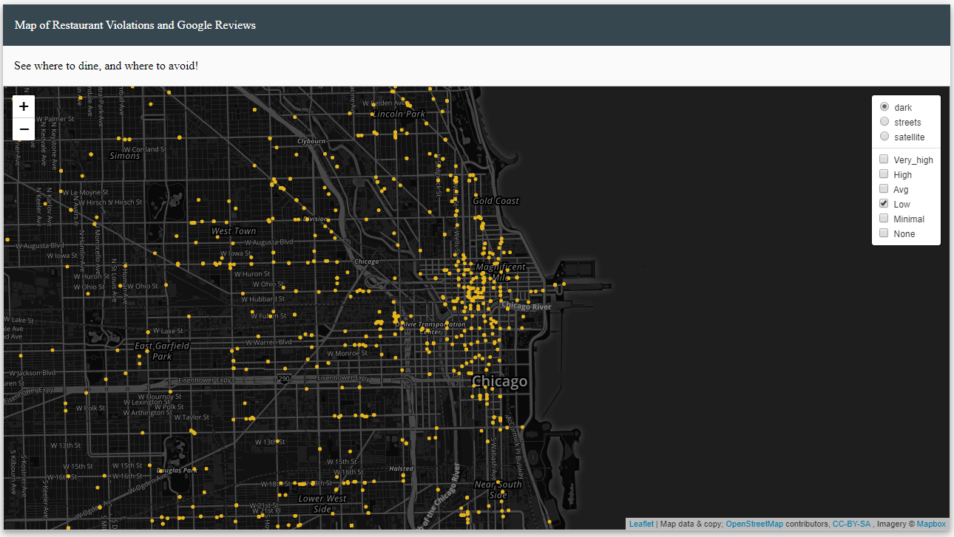
An Interactive Map

Slide 5
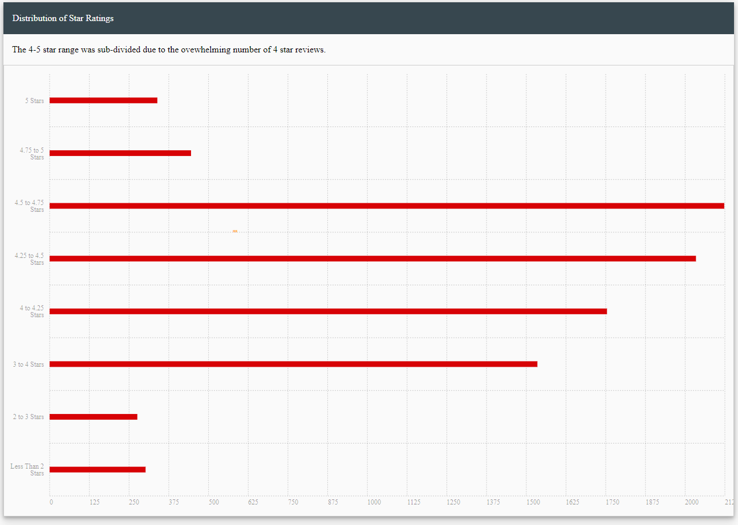
Distribution of Star Ratings

Slide 6
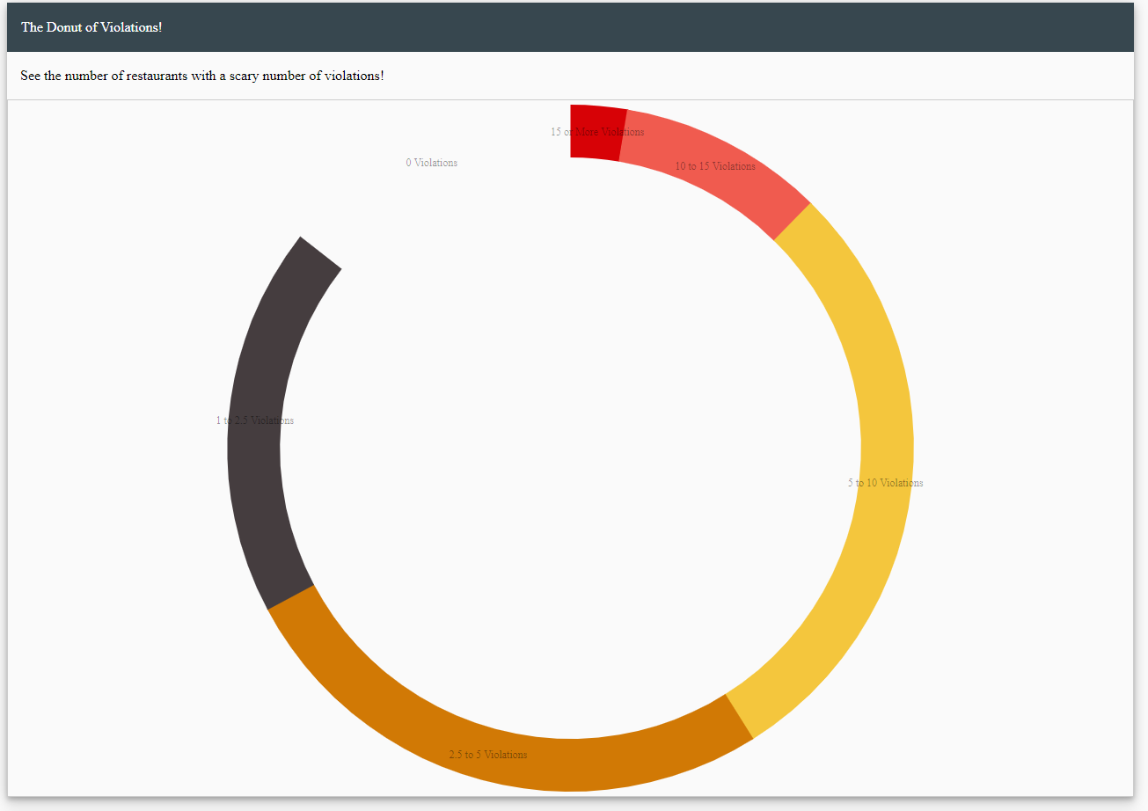
Counting Average Violations

Slide 7
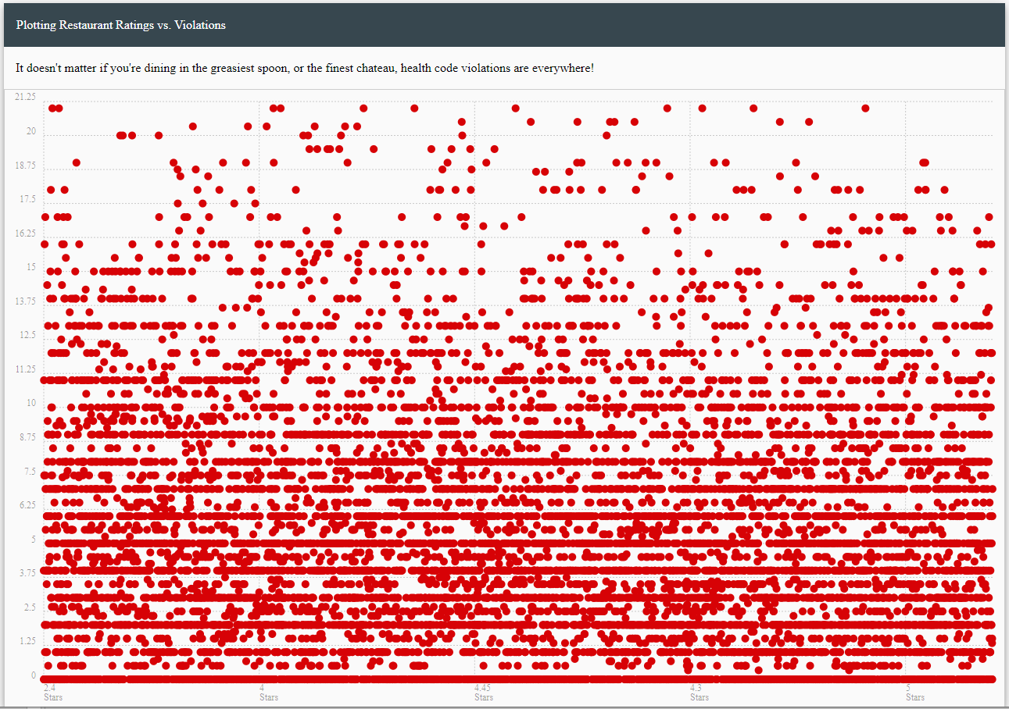
Comparing Ratings to Violations

Slide 8
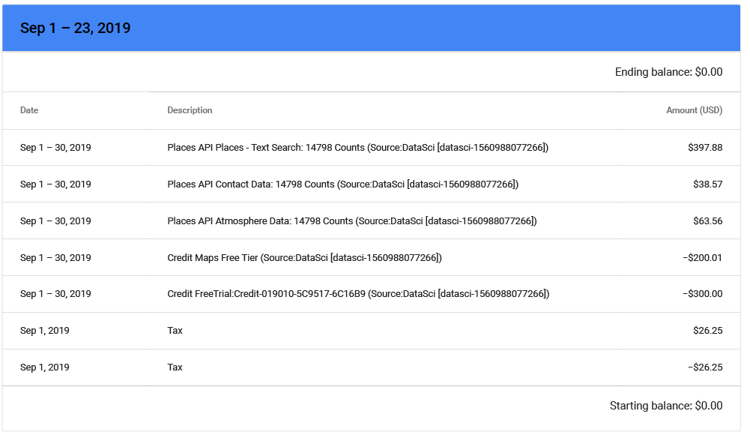
Beware of Google API Calls!

